Slide 1
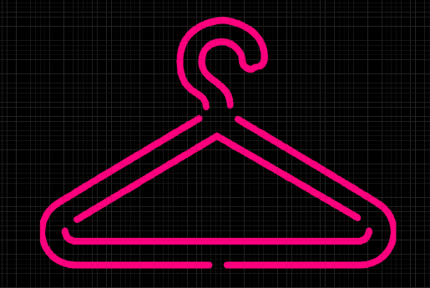
Virtual Wardrobe
Online Fashion Store
Contributed by
Raag Ranjan
Bachelor in Technology
Electronics and Communication Engineering
National Institute of Technology Patna

Slide 2
About
Virtual Wardrobe is an online store for clothing and accessories.
Customers can browse the website and choose the product they want.
They can also view the product in AR (Augmented Reality). It means that they can view the product in their surroundings with the help of their camera.
With AR technology, customers can try the products like clothes and accessories on themselves.
In this app, the customers can shop in various categories like men's wear, women's wear, kid's wear, watches, jewelry and many more.

Slide 3
Design
The UI/UX of this app was designed on Figma on a mobile phone wireframe.
It was designed such that customers find it easy to navigate and shop for products.
The AR (Augmented Reality) technology is simulated in the design too.
It gives us fair idea of what will the real Application will look and work like.

Slide 4
Augmented Reality
Customers can view the product in AR mode.
It allows them to look at the product and take a feel of what it will look like in their surroundings.
It allows the customers to try the products like clothes and accessories at the comfort of their homes.
To use the AR mode, the app asks for customer’s permission to access his/her camera.

Slide 5
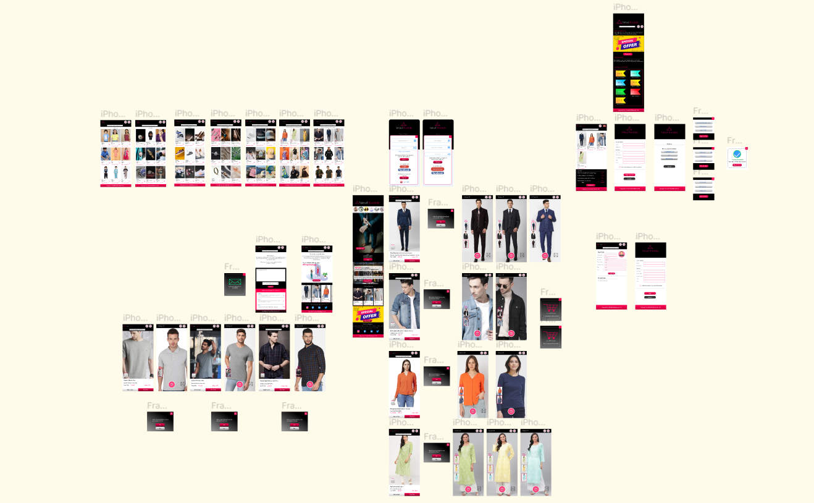
Wireframe of the App

Slide 6
Links
Click on below link to view the wireframe-
https://www.figma.com/file/hWrRPTlU3i4jESJizRNJl2/Virtual-Wardrobe?type=design&node-id=0%3A1&t=x0cXMtruGuabWdZj-1
Click on below link to try the prototype of the design-
https://www.figma.com/proto/hWrRPTlU3i4jESJizRNJl2/Virtual-Wardrobe?type=design&node-id=90-4&scaling=scale-down&page-id=0%3A1&starting-point-node-id=90%3A2192

Slide 7
Acknowledgement
The UI/UX design of Virtual Wardrobe was made by team The Kaalki Warriors which participated in the UI/UX Hackathon conducted by Hackslash NIT Patna.
Raag Ranjan was a part of the team and contributed in the concept, ideation and designing of the UI/UX of Virtual Wardrobe

